Slide 1

Applied Text Analytics ( F20/F21AA ) Text Classification (I) Heriot Watt University , Dubai Campus
Dr. Neamat El Gayar

Slide 2
Recap from last lecture
Sources of data
Cleaning data &Preprocessing:
Tokenization
Stop-words removal
Stemming
Vector Space Model
TF-IDF term weighting scheme

Slide 3
Vector space model
Each document is represented as a vector. All documents are projected into the space.
One dimension for every unique term in space(axes)
Cosine similarity
Jaccard Similarity
Finance
D₂
|D₂-D₄|
High-dimensional vector space: 10,000+ dimensions, or even 100,000+
D₄
D₃
Sports
Education
D₅
D₁
Notes:
For text, cosine similarity of tf.idf weighted vectors is typically most effective.
Similar results are obtained with the Jaccard and cosine coefficients
The Jaccard coefficient is especially useful for the case where the Boolean representation of text is used.

Slide 4
Document Vectorization
Document is represented with a numerical vector
Dimension of the vector =distinct terms in ”corpus”
Method | Function | Description | Comments
Binary “One-hot” | 0 1 | 1 if term occurs 0 otherwise | Can be suitable for shorter documents and NN implementations
Frequency | TF | Counts frequency of terms | Works well for k-means clustering and some probabilistic methods
Term Frequency Inverse Document Frequency | TF-IDF | Weights term by importance across corpus | Originally the gold- standard of Information retrieval
Can use N-gram features
Can be used in combination with PCA for dimensionality reduction
Notes:
Careful when using different types of normalization and pre-processing methods.
What works for one application domain might not work for another
Example: information retrieval settings vrs social network analysis

Slide 5
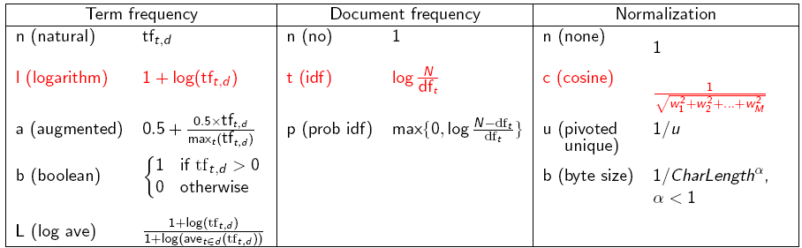
tf-idf weighting has many variants Introduction to Information Retrieval, 2019
Sec. 6.4
Columns headed ‘n’ are acronyms for weight schemes.
Why is the base of the log in idf immaterial?
Notes:
n default is just term frequency
ltc is best known form of weighting
Since this is the same for all terms, the choice doesn't really matter
Variations from one vector space scoring method to another hinge on the specific choices of weights in the vectors V⃗ (d) and V⃗ (q). Figure 6.15 lists some of the principal weighting schemes in use for each of V⃗ (d) and V⃗ (q), together with a mnemonic for representing a spe- cific combination of weights; this system of mnemonics is sometimes called SMART notation, following the authors of an early text retrieval system. The mnemonic for representing a combination of weights takes the form ddd.qqq where the first triplet gives the term weighting of the document vector, while the second triplet gives the weighting in the query vector. The first letter in each triplet specifies the term frequency component of the weighting, the second the document frequency component, and the third the form of nor- malization used. It is quite common to apply different normalization func- tions to V⃗ (d) and V⃗ (q). For example, a very standard weighting scheme is lnc.ltc, where the document vector has log-weighted term frequency, no idf (for both effectiveness and efficiency reasons), and cosine normalization, while the query vector uses log-weighted term frequency, idf weighting, and cosine normalization.

Slide 6
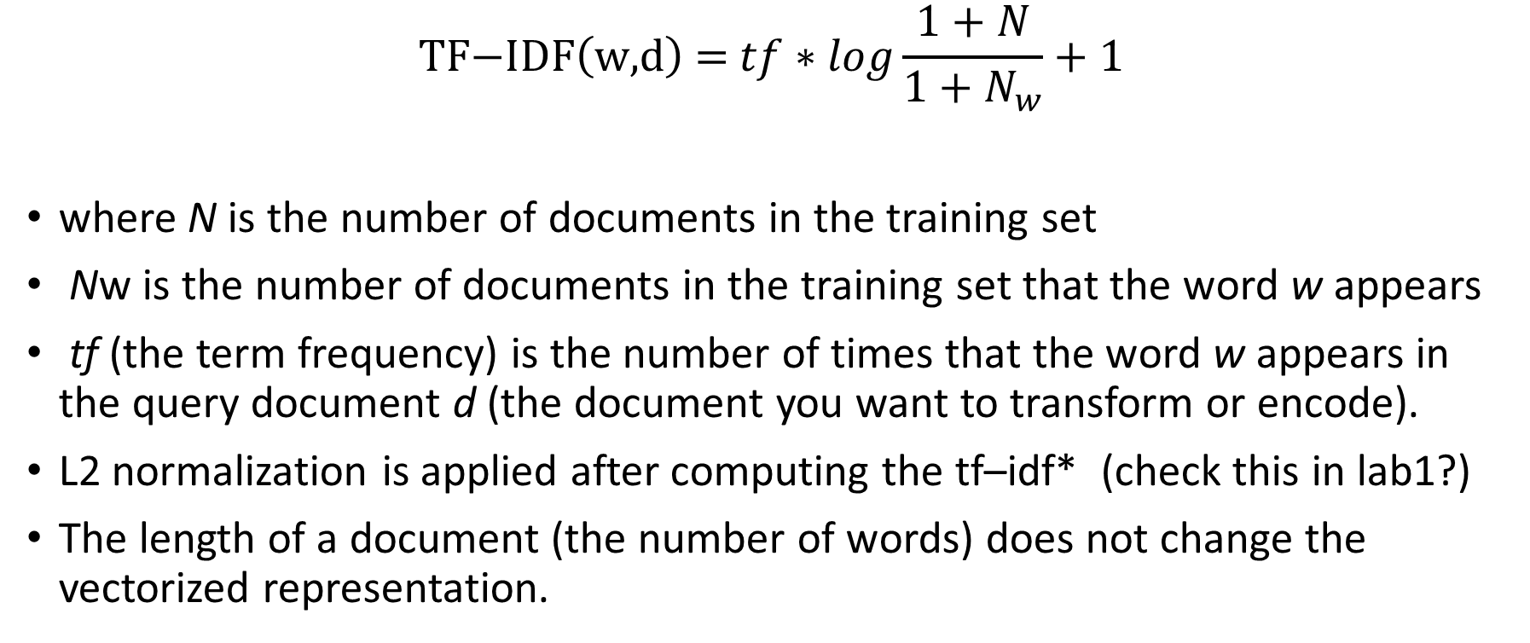
Scikit-learn tf-idf
$$\text{TF}\text{−}\text{IDF}\left(\text{w}\text{,}\text{d}\right) \text{=} tf∗log\frac{1+N}{1+N_{w}}+1$$
where N is the number of documents in the training set
Nw is the number of documents in the training set that the word w appears
tf (the term frequency) is the number of times that the word w appears in the query document d (the document you want to transform or encode).
L2 normalization is applied after computing the tf–idf* (check this in lab1?)
The length of a document (the number of words) does not change the vectorized representation.
Notes:
The L2 norm calculates the distance of the vector coordinate from the origin of the vector space. As such, it is also known as the Euclidean norm as it is calculated as the Euclidean distance from the origin. The result is a positive distance value.
(If you use l2-normalization, “unit norm” essentially means that if we squared each element in the vector, and summed them, it would equal 1 . ... note this normalization is also often referred to as, unit norm or a vector of length 1 or a unit vector )

Slide 7
Important research question
Binary representation , frequency count , Tf-idf ?
Applications like clustering & topic modelling have reported to work better with raw term frequencies
Stemming or Lemmatization? Stemming useful when mining very small documents like discussion board posts or tweets.
What works for one application domain might not work for another.
Notes:
Studies have shown that techniques like stemming can sometimes degrade classification accuracy when working with larger documents. [Charu C. Aggarwal. “Machine Learning for Text.”]

Slide 8
Topics of the lecture
Introduction to text classification
Vector Space model for text Classification
Similarity Measures for text Classification
Basic Classifiers (KNN – LR) + Movie Review example

Slide 9
Classification
Where in the catalog should I place this product listing?
Is this email spam?
Is this politician Democrat/Republican/Green?
Classification: assign labels to objects.
Usually supervised: training set of pre-classified examples.
Notes:
The primary task performed by classifiers is to assign labels to objects. Labels in classifiers are pre-determined unlike in clustering where we discover the structure and assign labels. Classifier problems are supervised learning methods. We start with a training set of pre-classified examples and with the knowledge of probabilities we assign class labels.
Some use case examples are shown in the slide. Based on the voting pattern on issues we could classify whether a politician has an affiliation to a party or a principle. Retailers use classifiers to assign proper catalog entry locations for their products. Most importantly the classification of emails as spam is another useful application of classifier methods.
Logistic regression, discussed in the previous lesson, can be viewed and used as a classifier. We will discuss Naïve Bayesian Classifiers in this lesson and the use of Decision Trees in the next lesson.

Slide 10
Text Classification
Assigning subject categories, topics, or genres
Spam detection
Authorship identification
Age/gender identification
Language Identification
Sentiment analysis
…

Slide 11
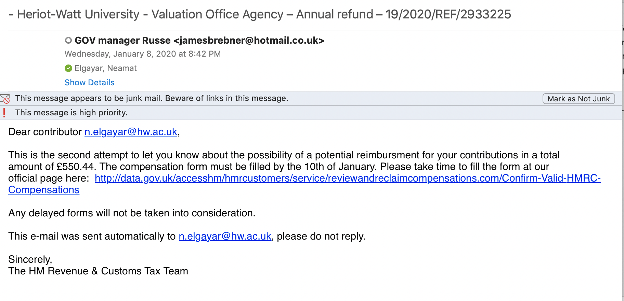
Is this spam?

Slide 12


Positive or negative movie review?
unbelievably disappointing
Full of zany characters and richly applied satire, and some great plot twists
this is the greatest screwball comedy ever filmed
It was pathetic. The worst part about it was the boxing scenes.

Slide 13
Classification Methods: Supervised learning
Sec. 13.1
Given:
A document d
A fixed set of classes: C = {c₁, c₂,…, c_{J}}
A training set D of documents each with a label in C
(d₁,c₁),....,(d_{m},c_{m})
Determine:
A learning method or algorithm which will enable us to learn a classifier γ
For a test document d, we assign it the class γ(d) ∈ C

Slide 14
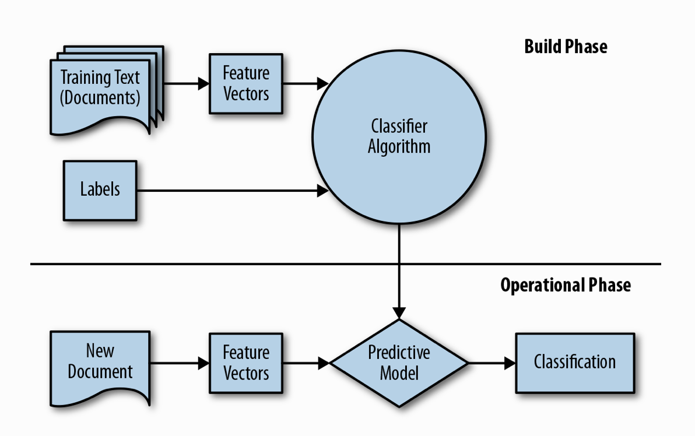
(Text) Classification

Slide 15
Basic Classification Methods
Introduction to Information Retrieval
Ch. 13
Supervised learning
Naive Bayes (simple, common)
k-Nearest Neighbors (simple, powerful)
Support-vector machines (generally more powerful)
Logistic Regression
Neural Networks,.. plus many other methods
Many commercial systems use a mixture of methods
Notes:
No free lunch: requires hand-classified training data
But data can be built up (and refined) by amateurs

Slide 16
Documents in a Vector Space
Sec.14.1
Government
Science
Arts

Slide 17
Test Document of what class?
Sec.14.1
Government
Science
Arts

Slide 18
Test Document = Government
Sec.14.1
Is this
similarity
hypothesis
true in
general?
Government
Science
Arts
Our focus: how to find good separators

Slide 19
Similarity measure

Slide 20
Euclidean Distance (Example)
“She sat down.
“She drank coffee.”
“She spent much time in learning text mining”
“She invested significant efforts in learning text mining”.
[Charu C. Aggarwal. “Machine Learning for Text.”]
Notes:
Distance (d1,d2)= root(4)=2. distance (d3,d4)=root(6)
“This problem was caused by the varying lengths of the documents. The Euclidean distance will consistently report higher values for distances between longer pairs of documents even if large fractions of those documents are in common. ”
Excerpt From: Charu C. Aggarwal. “Machine Learning for Text.” Apple Books.

Slide 21
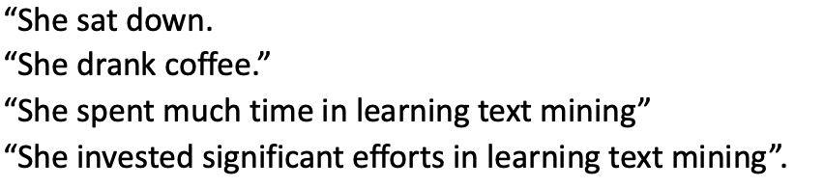
Solved example
 | coffee | down | drank | effort | in | invest | learning | mining | much | sat | she | significant | spent | text | time
D1
D2
D3
D4

Slide 22
Solved example
 | coffee | down | drank | effort | in | invest | learning | mining | much | sat | she | significant | spent | text | time
D1 |  | 1 |  |  |  |  |  |  |  | 1 | 1
D2 | 1 |  | 1 |  |  |  |  |  |  |  | 1
D3 |  |  |  |  | 1 |  | 1 | 1 | 1 |  | 1 |  | 1 | 1 | 1
D4 |  |  |  | 1 | 1 | 1 | 1 | 1 |  |  | 1 | 1 |  | 1
Distance (d1,d2)= sqrt(4)=2. distance (d3,d4)=sqrt(6)=2.65

Slide 23
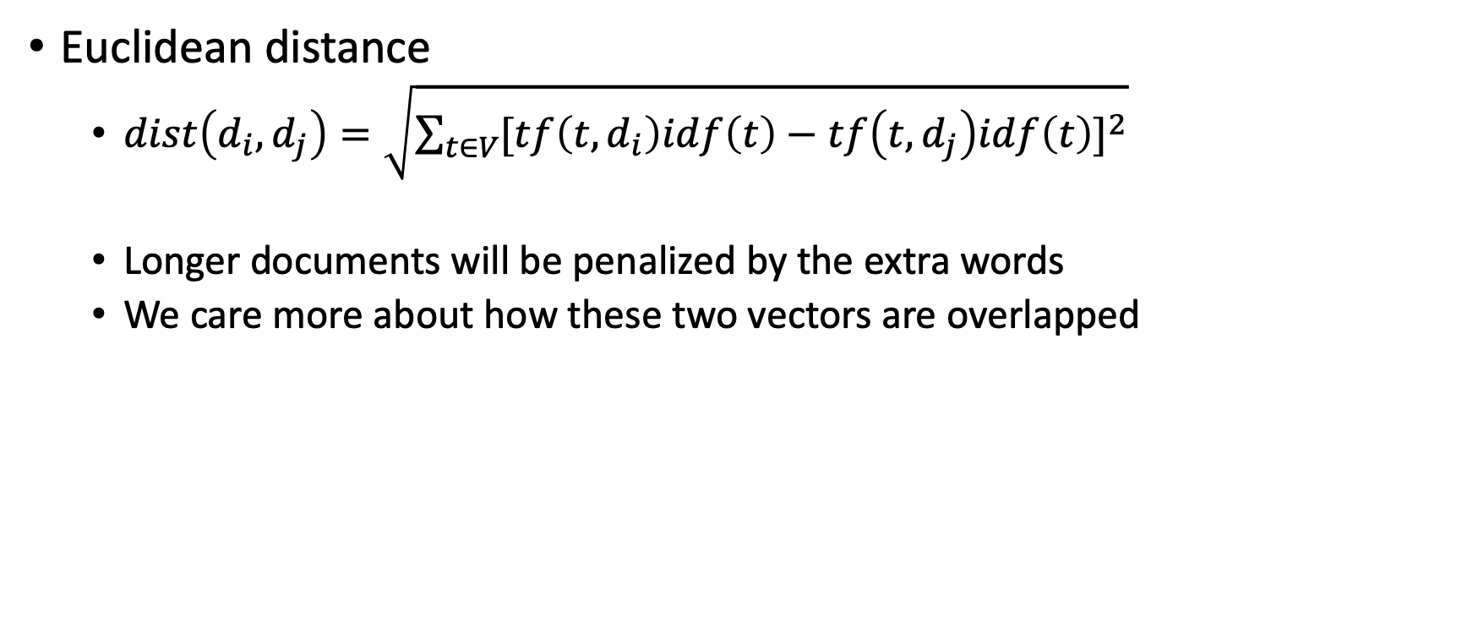
How to define a good similarity metric?
Euclidean distance
$dist\left(d_{i},d_{j}\right)=\sqrt{\sum_{t∈V}{{[tf\left(t,d_{i}\right)idf\left(t\right)−tf\left(t,d_{j}\right)idf\left(t\right)]}^{2}}}$
Longer documents will be penalized by the extra words
We care more about how these two vectors are overlapped

Slide 24
How to define a good similarity metric?
Euclidean distance?
Finance
TF-IDF space
D₂
D₄
D₃
Sports
D₆
D₅
D₁
Education
Notes:
Note here that D6 makes a rather large angle with D2 and obviously a small one with D1. If Euclidean distance is used, there is a chance that D2 could be seen as nearer to D6 (taking into account all features). However, the angle between D6 and D1 is the smallest – so using an angle-based metric may find this answer.

Slide 25
From distance to angle
Angle: how vectors are overlapped
Cosine similarity – projection of one vector onto another
Finance
TF-IDF space
D₁
The choice of angle
The choice of Euclidean distance
D₂
D₆
Sports
Notes:
This is another perspective of the same example, showing that D2 and D6 are indeed vectors with small coefficients – Euclidean distance wise, they are near. But by angle measurement, D6 is nearer to D1.

Slide 26
Euclidean distance for text classification
Not good in computing distances in multidimensional representations that are very sparse.
This occurs frequently in the case of text because of the varying lengths of different documents.
Can lead to poor mining results in which longer and shorter documents are not treated with an even hand.
Notes:
By “very sparse” (first point) here means that the vectors (in vector space) are very different from each other and hence leaves a lot of gaps in the space. This sparsity will result in very large distances computing by Euclidean distance.

Slide 27
Cosine similarity (document q , document d )
Sec. 6.3
Dot product
Unit vectors
q_{i} is the tf-idf weight of term i in the query
d_{i} is the tf-idf weight of term i in the document
cos(q,d) is the cosine similarity of q and d … or,
equivalently, the cosine of the angle between q and d.
Documents are normalized by length
Notes:
See Law of Cosines (Cosine Rule) wikipedia page
Euclidean distance is a bad idea . . .
. . . because Euclidean distance is large for vectors of different lengths.

Slide 28
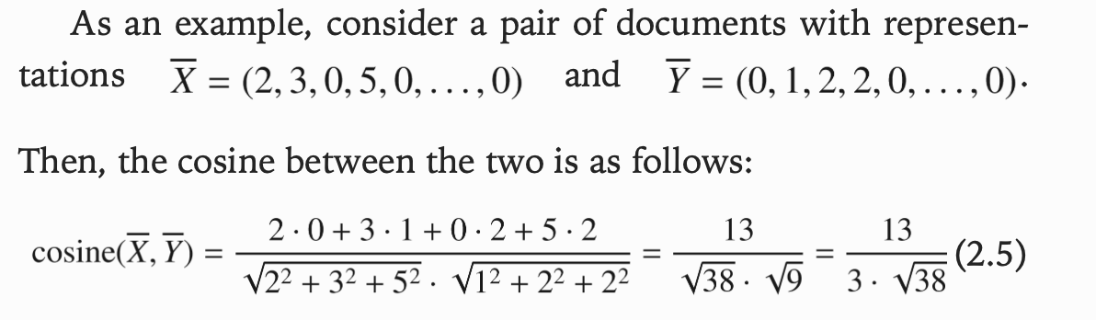
Example: Cosine Similarity

Slide 29
Cosine Similarity
Cosine computation is largely dependent on the fraction of common words in each of the documents
Euclidean distance, the dot product, or the cosine similarity for retrieval applications are the same if documents are normalized to same length

Slide 30
Similarity for Boolean representation of text

Slide 31
Solved example
 | coffee | down | drank | effort | in | invest | learning | mining | much | sat | she | significant | spent | text | time
D1 |  | 1 |  |  |  |  |  |  |  | 1 | 1
D2 | 1 |  | 1 |  |  |  |  |  |  |  | 1
D3 |  |  |  |  | 1 |  | 1 | 1 | 1 |  | 1 |  | 1 | 1 | 1
D4 |  |  |  | 1 | 1 | 1 | 1 | 1 |  |  | 1 | 1 |  | 1
Jacc Sim (d1,d2)= 1/(5)=0.2 Jacc Sim (d3,d4)= 5/(11)=0.45

Slide 32
Jaccard coefficient for tf-idf representation

Slide 33
Summary of Similarity Metrics
Sec.14.3
Simplest for continuous m-dimensional instance space is Euclidean distance. ( for general ML/data mining applications)
For text, cosine similarity of tf.idf weighted vectors is typically most effective.
Similar results are obtained with the Jaccard and cosine coefficients
The Jaccard coefficient is especially useful for the case where the Boolean representation of text is used.

Slide 34
Exercise 1 ( continued)
Use the following distance metrics to sort your documents by similarity:
Euclidean Distance
Cosine similarity
Jaccard Similarity
Compare your results

Slide 35
Some empirically reported results (to verify)
Binary representation , frequency count , Tf-idf ?
Applications like clustering & topic modelling have reported to work better with raw term frequencies
Stemming useful when mining very small documents like discussion board posts or tweets.
Studies have shown that techniques like stemming can sometimes degrade classification accuracy when working with larger documents. [Charu C. Aggarwal. “Machine Learning for Text.”]

Slide 36
So….any recommendations?
Careful when using different types of normalization and pre-processing methods.
What works for one application domain might not work for another
Example: information retrieval settings vrs social network analysis
You will experiment with this in your COURSEWORK

Slide 37
Simple Classifiers
Introduction to Information Retrieval
Ch. 13
Supervised learning
Naive Bayes (simple, common)
k-Nearest Neighbors (simple, powerful)
Support-vector machines (generally more powerful)
Logistic Regression … plus many other methods
Many commercial systems use a mixture of methods
Notes:
No free lunch: requires hand-classified training data
But data can be built up (and refined) by amateurs

Slide 38
k Nearest Neighbor Classification
Sec.14.3
kNN = k Nearest Neighbor
To classify a document d into class c:
Define k-neighborhood N as k nearest neighbors of d
Count number of documents i in N that belong to c (based on similarity metric)
Estimate P(c|d) as i/k
Choose as class argmax_{c} P(c|d) [ = majority class]
Unlike all the previous learning methods, kNN does not build model from the training data.
For text, cosine similarity of tf.idf weighted vectors are typically most effective.
Notes:
Nearest neighbor method depends on a similarity (or distance) metric.
We are not computing a model or a prototypical representation of a class
NB- you learn the probability and discard the training samples
In Rocchio algorithm you compute the center of each class and forget about the training classes

Slide 39
Example: k=6 (6NN)
Sec.14.3
P(science| )?
Government
Science
Arts
Notes:
We are not computing a model or a prototypical representation of a class
NB- you learn the probability and discard the training samples
In Rocchio algorithm you compute the center of each class and forget about the training classes

Slide 40
kNN decision boundaries
Sec.14.3
Boundaries are in principle arbitrary surfaces – but usually polyhedra
Government
Science
Arts
kNN gives locally defined decision boundaries between classes – far away points do not influence each classification decision (unlike in Naïve Bayes, Rocchio, etc.)

Slide 41
Example: k=6 (6NN)
Government
Science
Arts
A new point
Pr(science| )?

Slide 42
kNN Algorithm
k is usually chosen empirically via a validation set or cross-validation by trying a range of k values.
Distance function is crucial, but depends on applications.
Again for text ( cosine-similarity)

Slide 43
kNN Summary
kNN can deal with complex and arbitrary decision boundaries.
Despite its simplicity, researchers have shown that the classification accuracy of kNN can be quite strong and in many cases as accurate as those elaborated methods.
kNN is slow at the classification time
kNN does not produce an understandable model
In most cases it’s more accurate than NB or Rocchio

Slide 44
Logistic Regression
Linear Classifier
Notes:
(Don’t worry about the math ….just get the general idea behind SVM)

Slide 45
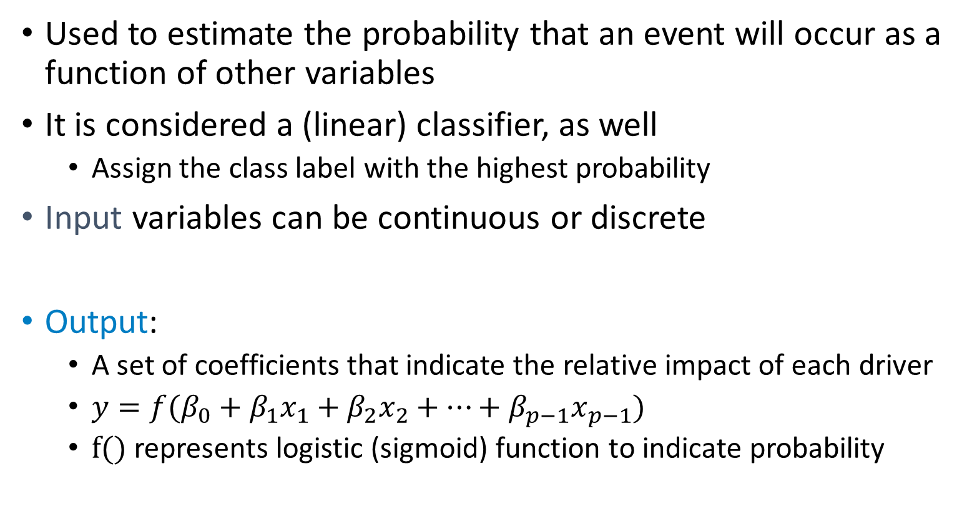
Logistic Regression
Used to estimate the probability that an event will occur as a function of other variables
It is considered a (linear) classifier, as well
Assign the class label with the highest probability
Input variables can be continuous or discrete
Output:
A set of coefficients that indicate the relative impact of each driver
$y=f(β_{0}+β_{1}x_{1}+β_{2}x_{2}+⋯+β_{p−1}x_{p−1}$)
f() represents logistic (sigmoid) function to indicate probability
Notes:
Linear

Slide 46
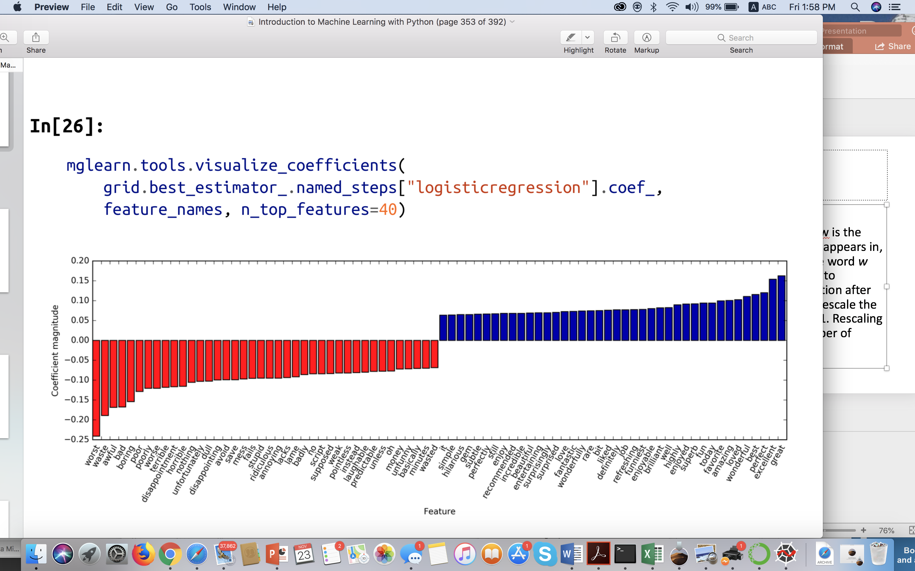
Coefficient of Logistic Regression
+

Slide 47
Example Application: Sentiment Analysis of Movie
Given : dataset of movie reviews from the IMDb (Internet Movie Database)
Dataset contains the text of the reviews, together with a label that indicates whether a review is “positive” or “negative.”
Chapter 7: An Introduction to Machine Learning with Python by Andreas C. Müller and Sarah Guido (O’Reilly). 2017 978-1-449-36941-5. Check Ebook and Github Code
Notes:
The IMDb website itself contains ratings from 1 to 10. To simplify the modeling, this annotation is summarized as a two-class classification dataset where reviews with a score of 6 or higher are labeled as positive, and the rest as negative.

Slide 48
Sentiment Analysis of Movie Reviews
Positive class and the negative class are balanced
The dataset is provided as text files
For each class (pos/neg) training data -test data is available
Objective: Given a review, assign the label “positive” or “negative” based on the text content of the review. This is a standard binary classification task.

Slide 49
Coefficient of Logistic Regression
+

Slide 50
Coming up next
Keep following canvas :
Exercise 1 ( Text Representation - Similarity Measures – NB classifier)
Lab 2 week 3: Sentiment analysis of movie review data
Recommended preparation: Scikit-Learn for text processing and classification (self-study overview lectures I & II)

Slide 51
Questions?

